Slide 1
Amortized Analysis
The problem domains vary widely, so this approach is not tied to any single data structure
The goal is to guarantee the average performance of each operation in the worst case
Three methods
  aggregate method
  accounting method
  potential method
Two problems
  stack operations, including a multipop
  binary counter using the increment operation

Slide 2
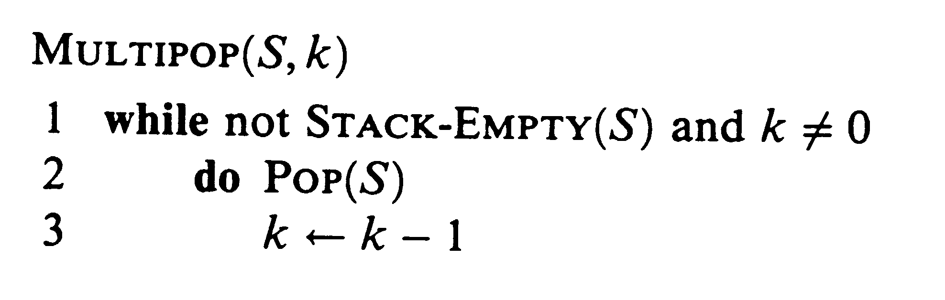
Stack Operations
Goal
  find worst case time, T(n), for n operations
  the amortized cost is T(n) / n
Push and Pop
  Push(x, S) has complexity O(1)
  Pop(S) returns popped object, complexity is O(1)
Multipop operation
  complexity is min(s,k) where s is the stack size

Slide 3
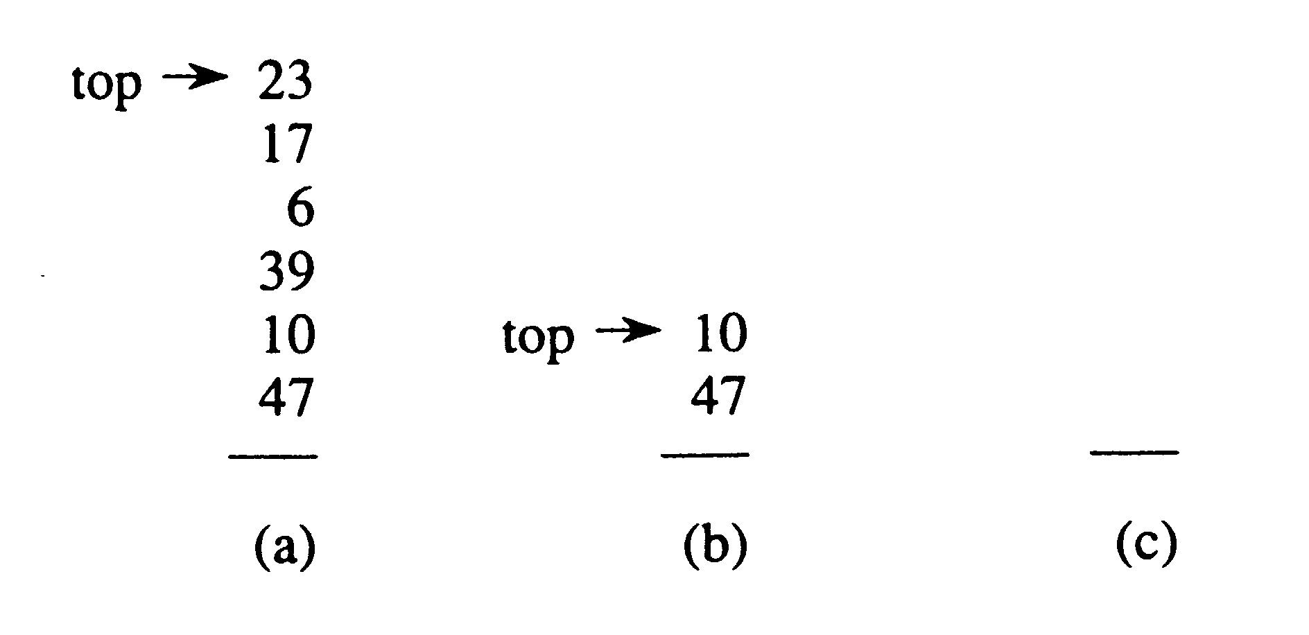
A Simple Analysis
Start with empty stack
  Stack can be no larger than O(n)
  So a multipop operation could have complexity O(n)
  Since there are n operations, an upper bound on complexity is O(n²)
Although this is a valid upper bound, it grossly overestimates the upper bound

Slide 4
An Amortized Analysis
Claim - any sequence of push, pop, multipop has at most worst case complexity of O(n)
  each object can be popped at most one time for each time it is pushed
  the number of push operations is O(n) at most
  so the number of pops, either from pop or multipop, is at most O(n)
  the overall complexity is O(n)
The amortized cost is O(n)/n = O(1)
Question - would this still be true if we had a multipush and a multipop?

Slide 5
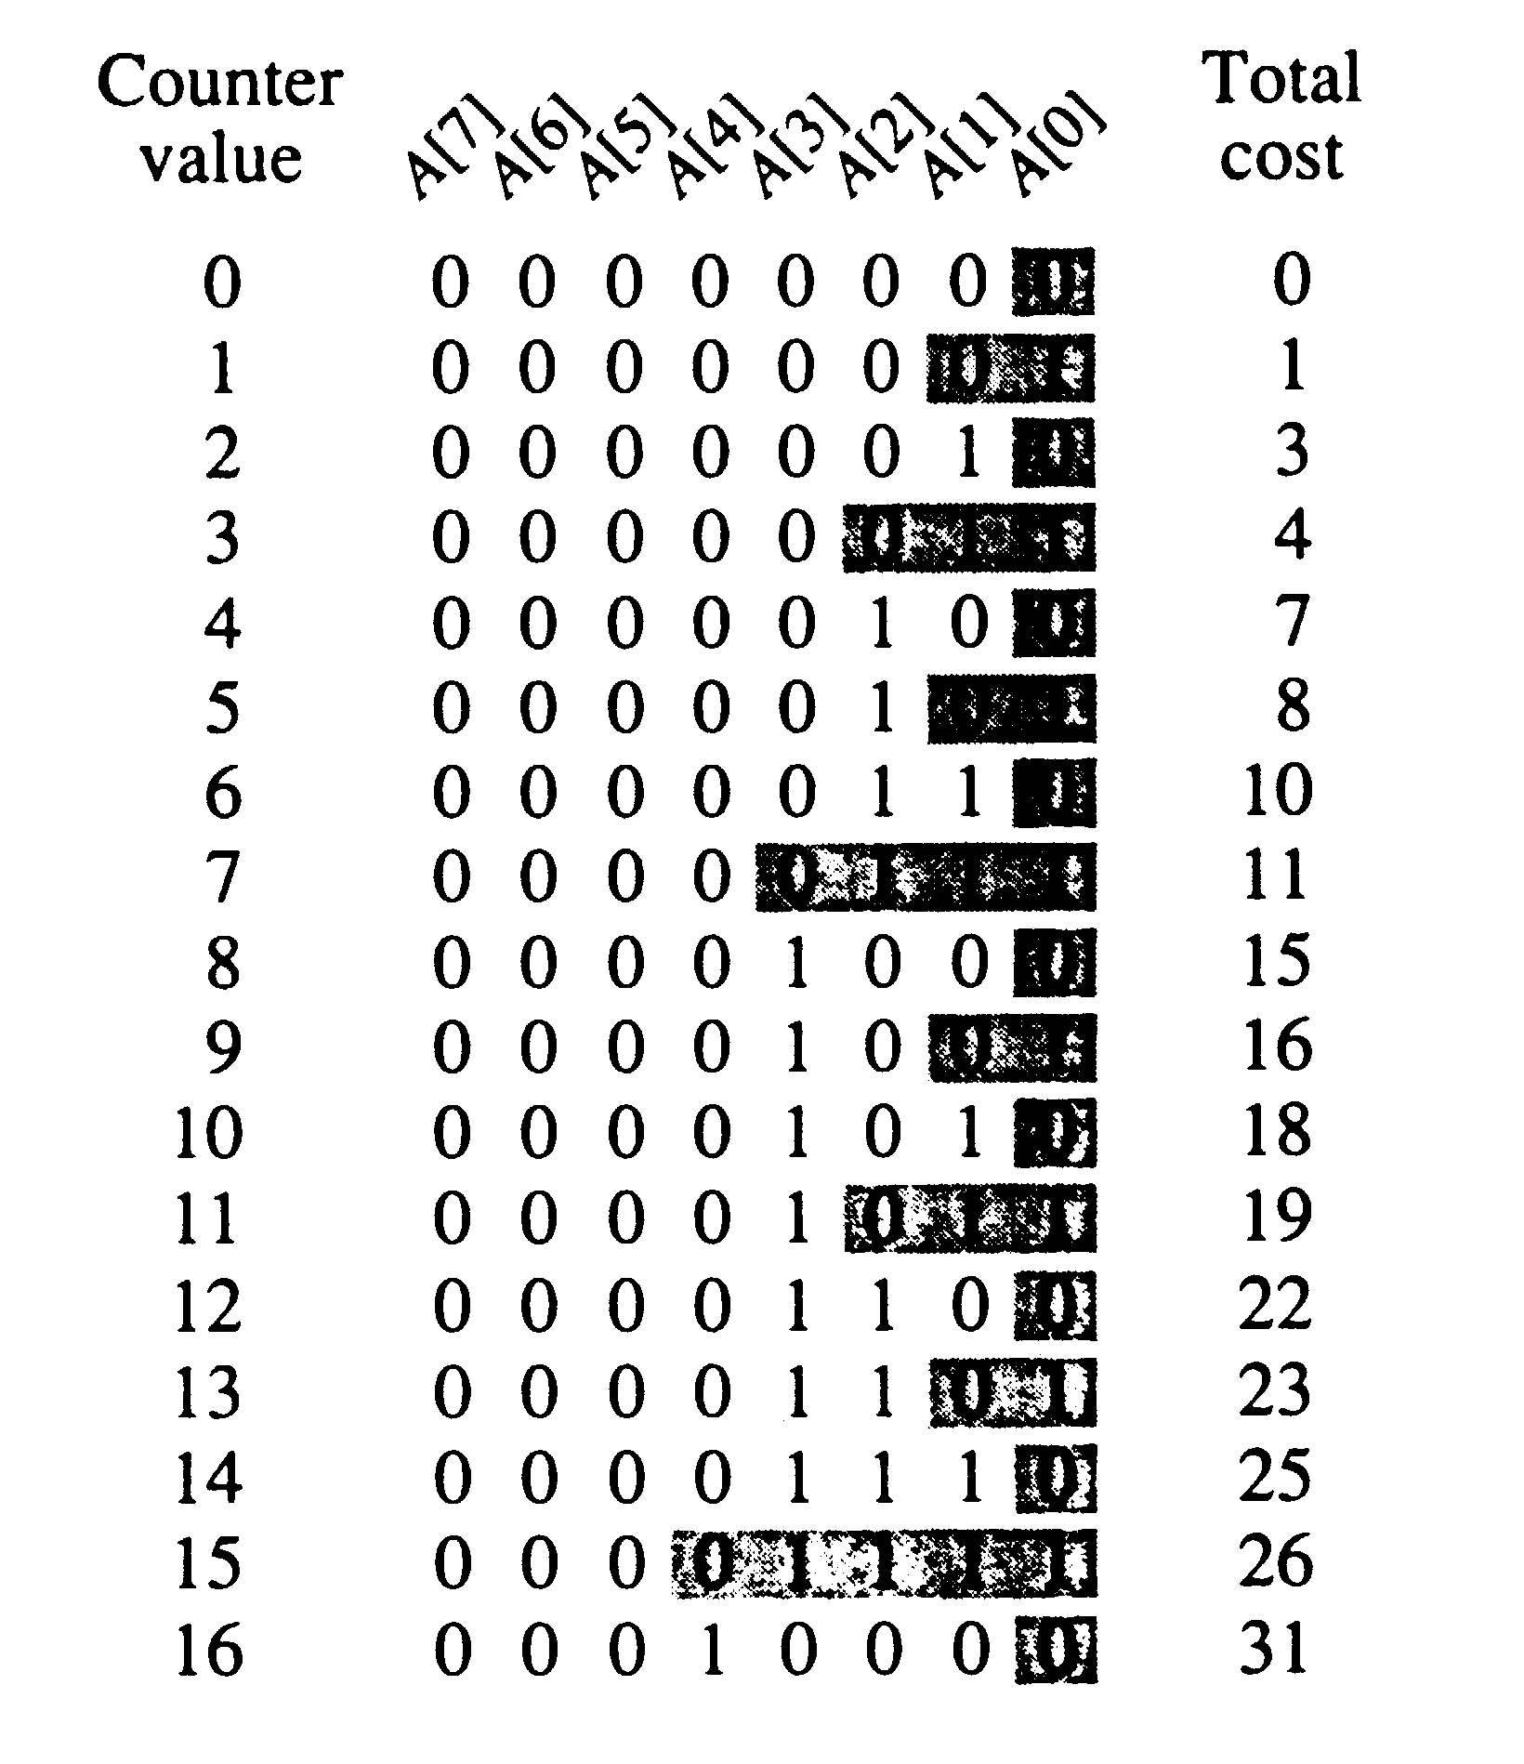
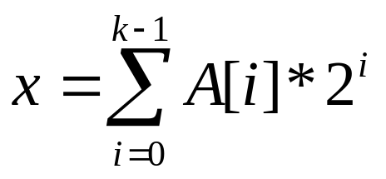
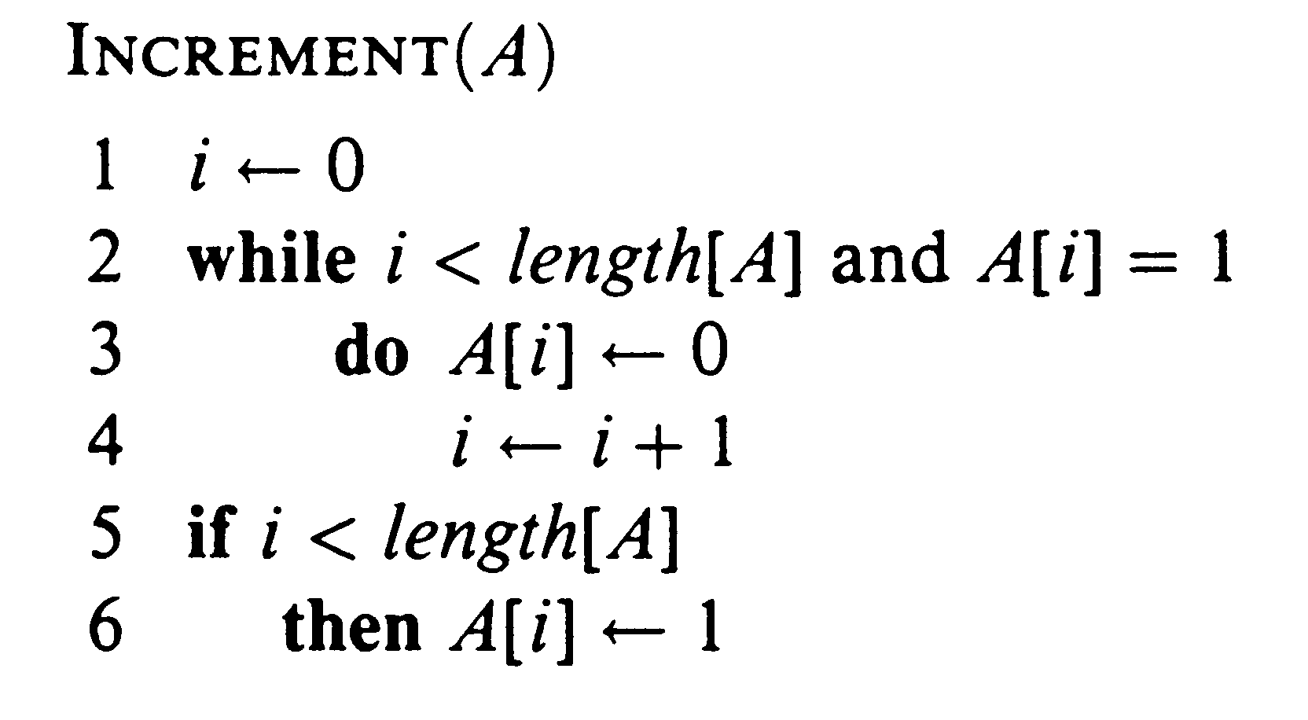
Incrementing Binary Numbers
Assume bits A[k-1] to A[0]
Incrementing starting from 0
The diagram to the right counts the number of bit flips; for the first 16 numbers the total cost is 31; in general, for n increments, what will the complexity be?

Slide 6
A Simple Analysis
We measure cost as the number of bit flips
  some operations only flip one bit
  other operations ripple through the number and flip many bits
  what is the average cost per operation?
A cursory analysis
  worst case for the increment operation is O(k)
  a sequence of n increment operations would have worst case behavior of O( n k )
Although this is an upper bound, it is not very tight

Slide 7
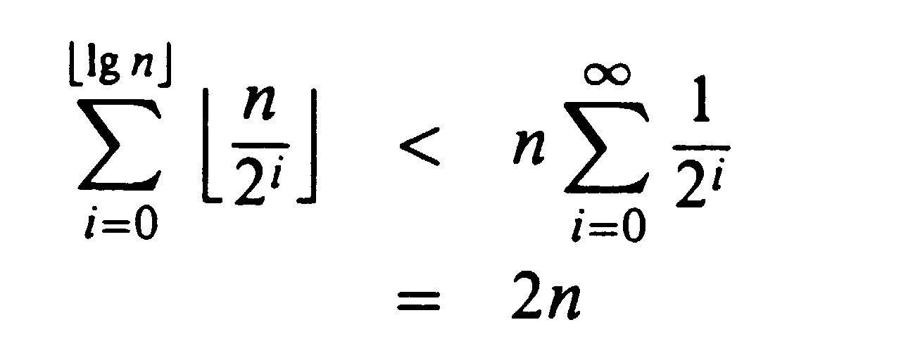
An Amortized Analysis
Not all bits are flipped each iteration
  A[0] is flipped every iteration; A[1] every other iteration
  A[2] every fourth, and so forth
  for i > ⎣lg n⎦, the bit A[i] never flips
  summing all the bit flips we have
So it turns out the worst case is bounded by O(n)
Therefore O(n) / n is only O(1) !

Slide 8
The Accounting Method
Different charges are assigned to different operations
  overcharges result in a credit
  credits can be used later to help perform other operations whose amortized cost is less than actual
  this is very different than the aggregate method in which all operations have the same amortized cost
Choice of amortized amounts
  the total amortized cost for any sequence must be an upper bound on the actual costs
  the total credit assignment must be nonnegative
  so the amortized amounts selected must never result in a negative credit

Slide 9
Stack Operations
  Operation Actual cost Amortized cost
  Push 1 2
  Pop 1 0
  Multipop min(s,k) 0
Rationale
  since we start with an empty stack, pushes must be done first and this builds up the amortized credit
  all pops are charged against this credit; there can never be more pops (of either type) than pushes
  therefore the total amortized cost is O(n)

Slide 10
Incrementing a Binary Counter
Amortized cost
  2 for setting a bit to 1
  0 for setting a bit to 0
  the credits for any number
  are the number of 1 bits
Analysis of the increment operation
  the while loop resetting bits is charged against credits
  only one bit is set in line 6, so the total charge is 2
  since the number of 1’s is never negative, the amount of credit is also never negative
  the total amortized cost for n increments is O(n)

Slide 11
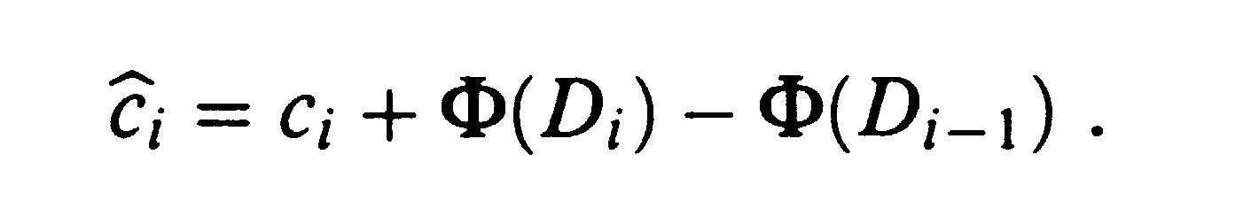
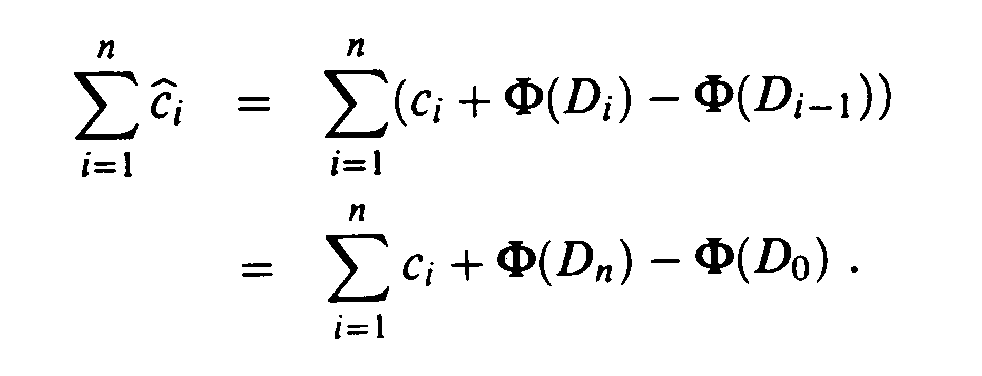
The Potential Method
Potential is the accumulation of credits
  it is associated with the entire data structure rather than individual objects; φ(D_{i}) is a real number associated with the structure D_{i}
  the amortized cost is
  the total amortized cost is
  if we insure that
  φ(D_{i}) >= φ(D₀)
  then the potential never becomes negative
  it is often convenient to let φ(D₀) = 0 then it only needs to be shown that all φ(D_{i}) are nonnegative

Slide 12
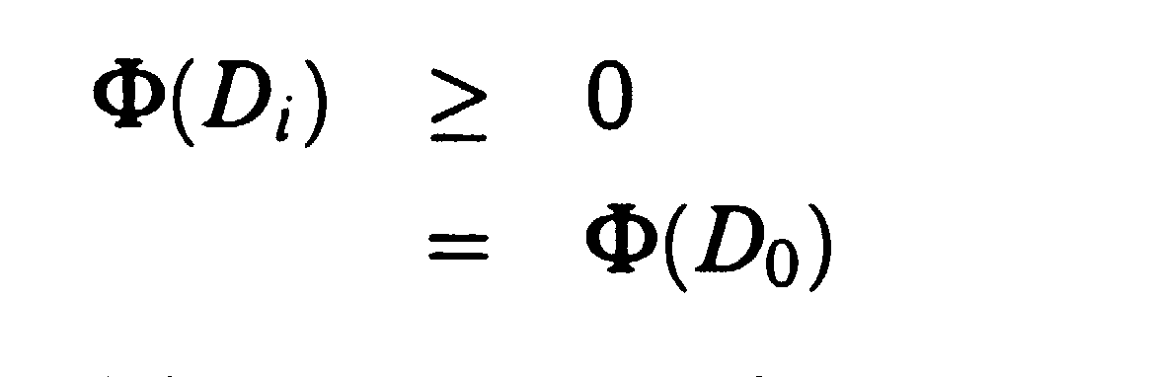
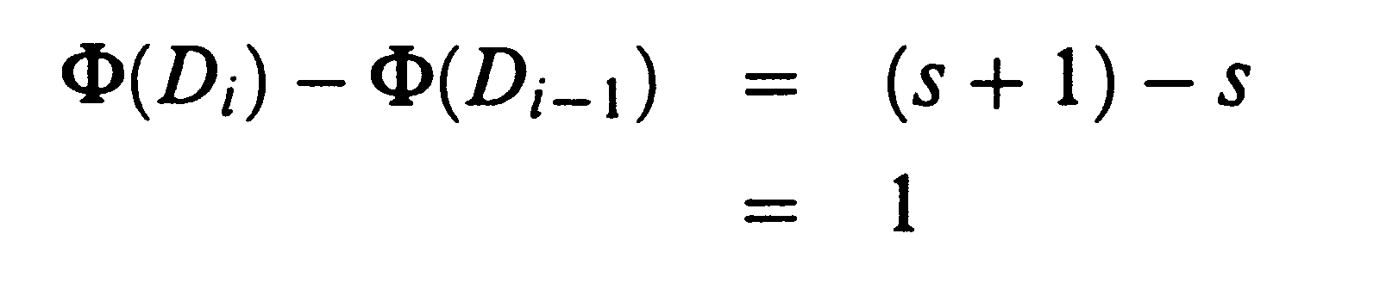
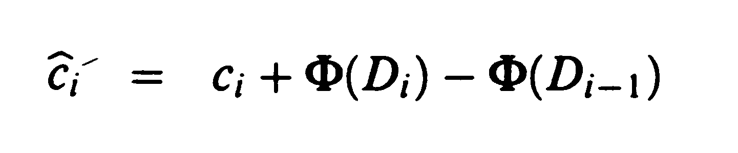
Stack Operations - 1
The potential function is the size of the stack
  the total amortized cost of n
  operations with respect to φ
  is an upper bound for the actual cost
The push operation
  so
The pop operation
  the difference in potential for the pop operation is -1
  so the amortized cost is 1 + (-1) = 0
= 2

Slide 13

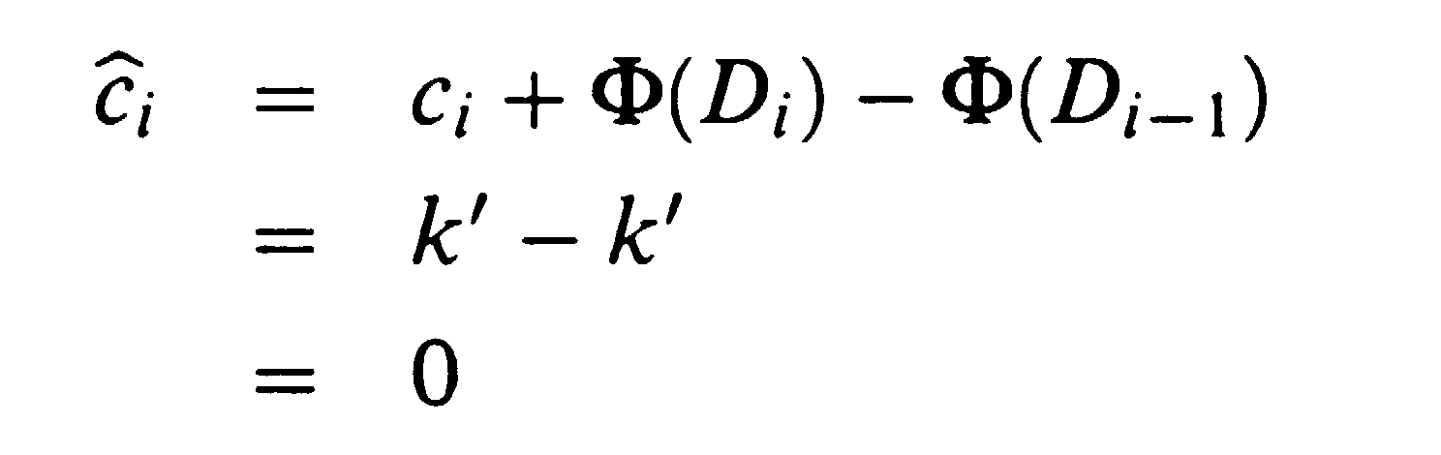
Stack Operations - 2
The multipop operation
where k’ = min(k,s)
so
Total amortized cost
  Each operation has an amortized cost of O(1)
  For n operations, the total amortized cost is O(n)
  Since the potential function meets all of our requirements, the total cost is a valid upper bound

Slide 14
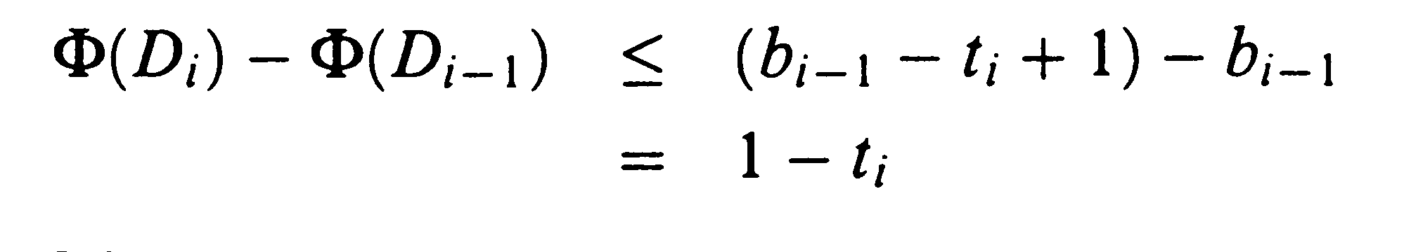
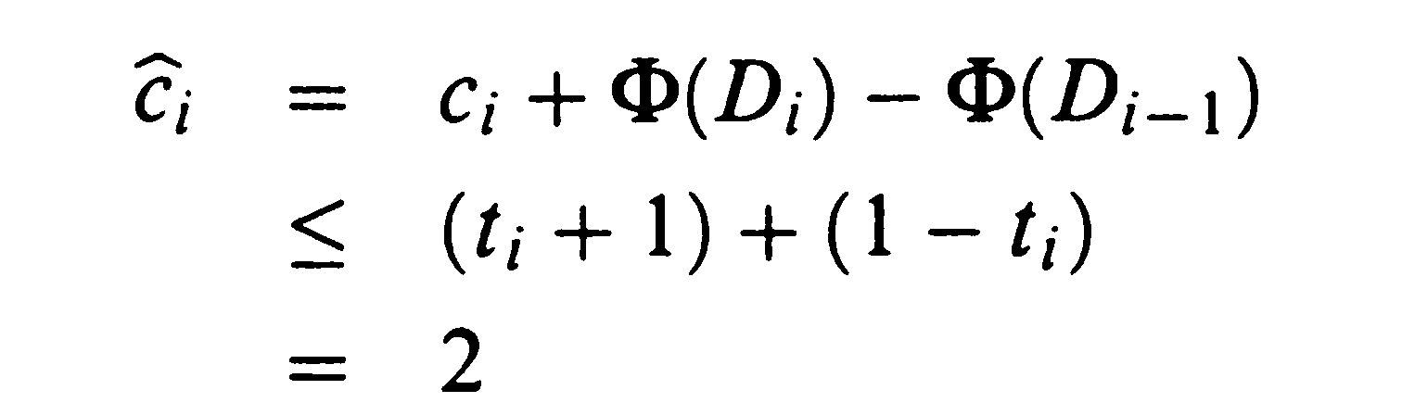
Incrementing a Binary Counter - 1
Potential function - the number of 1s in the count after the i^{th} operation
Amortized cost of the i^{th} increment operation
  suppose that t_{i} bits are reset and one bit is set
  since the actual cost is t_{i} + 1, we have
Therefore, for n operations, the total cost is O(n)

Slide 15
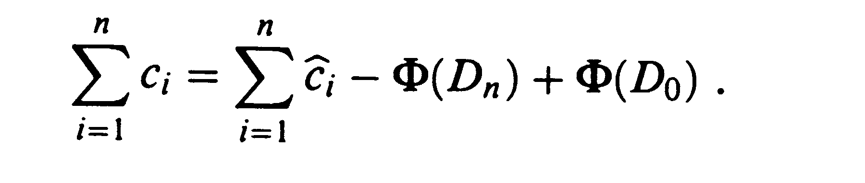
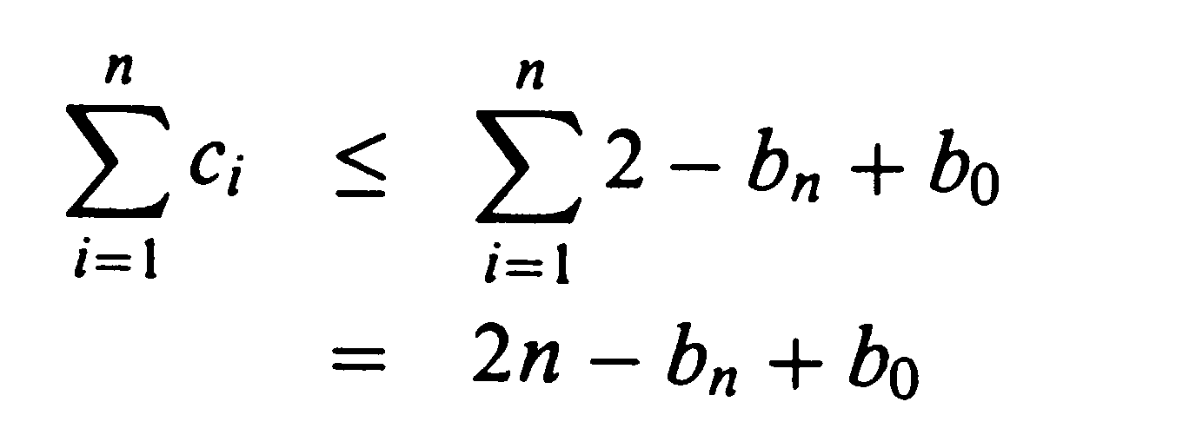
Incrementing a Binary Counter - 2
Suppose the counter is not initially zero
  there are b₀ initial 1s and after n increments b_{n} 1s
  But the amortized cost for c are each 2, so
Total cost
  since b₀ < k, if we executed at least n = Ω(k) increment operations, then the total cost is no more than O(n) no matter what the starting value of the counter

Slide 16
Dynamic Tables
Dynamic tables expand and contract in size according to the amount of data being held
  the organization of the table is unimportant, for simplicity we will show an array structure
  the load factor α(T) of a nonempty table equals the number of items in the table divided by the table size
  an empty table has size 0 and load factor 1
  when we try to insert an item into a full table, we will double the size of the table
  when the load factor is too low we will contract the table
Java vectors act in this way (at least for expansion)

Slide 17
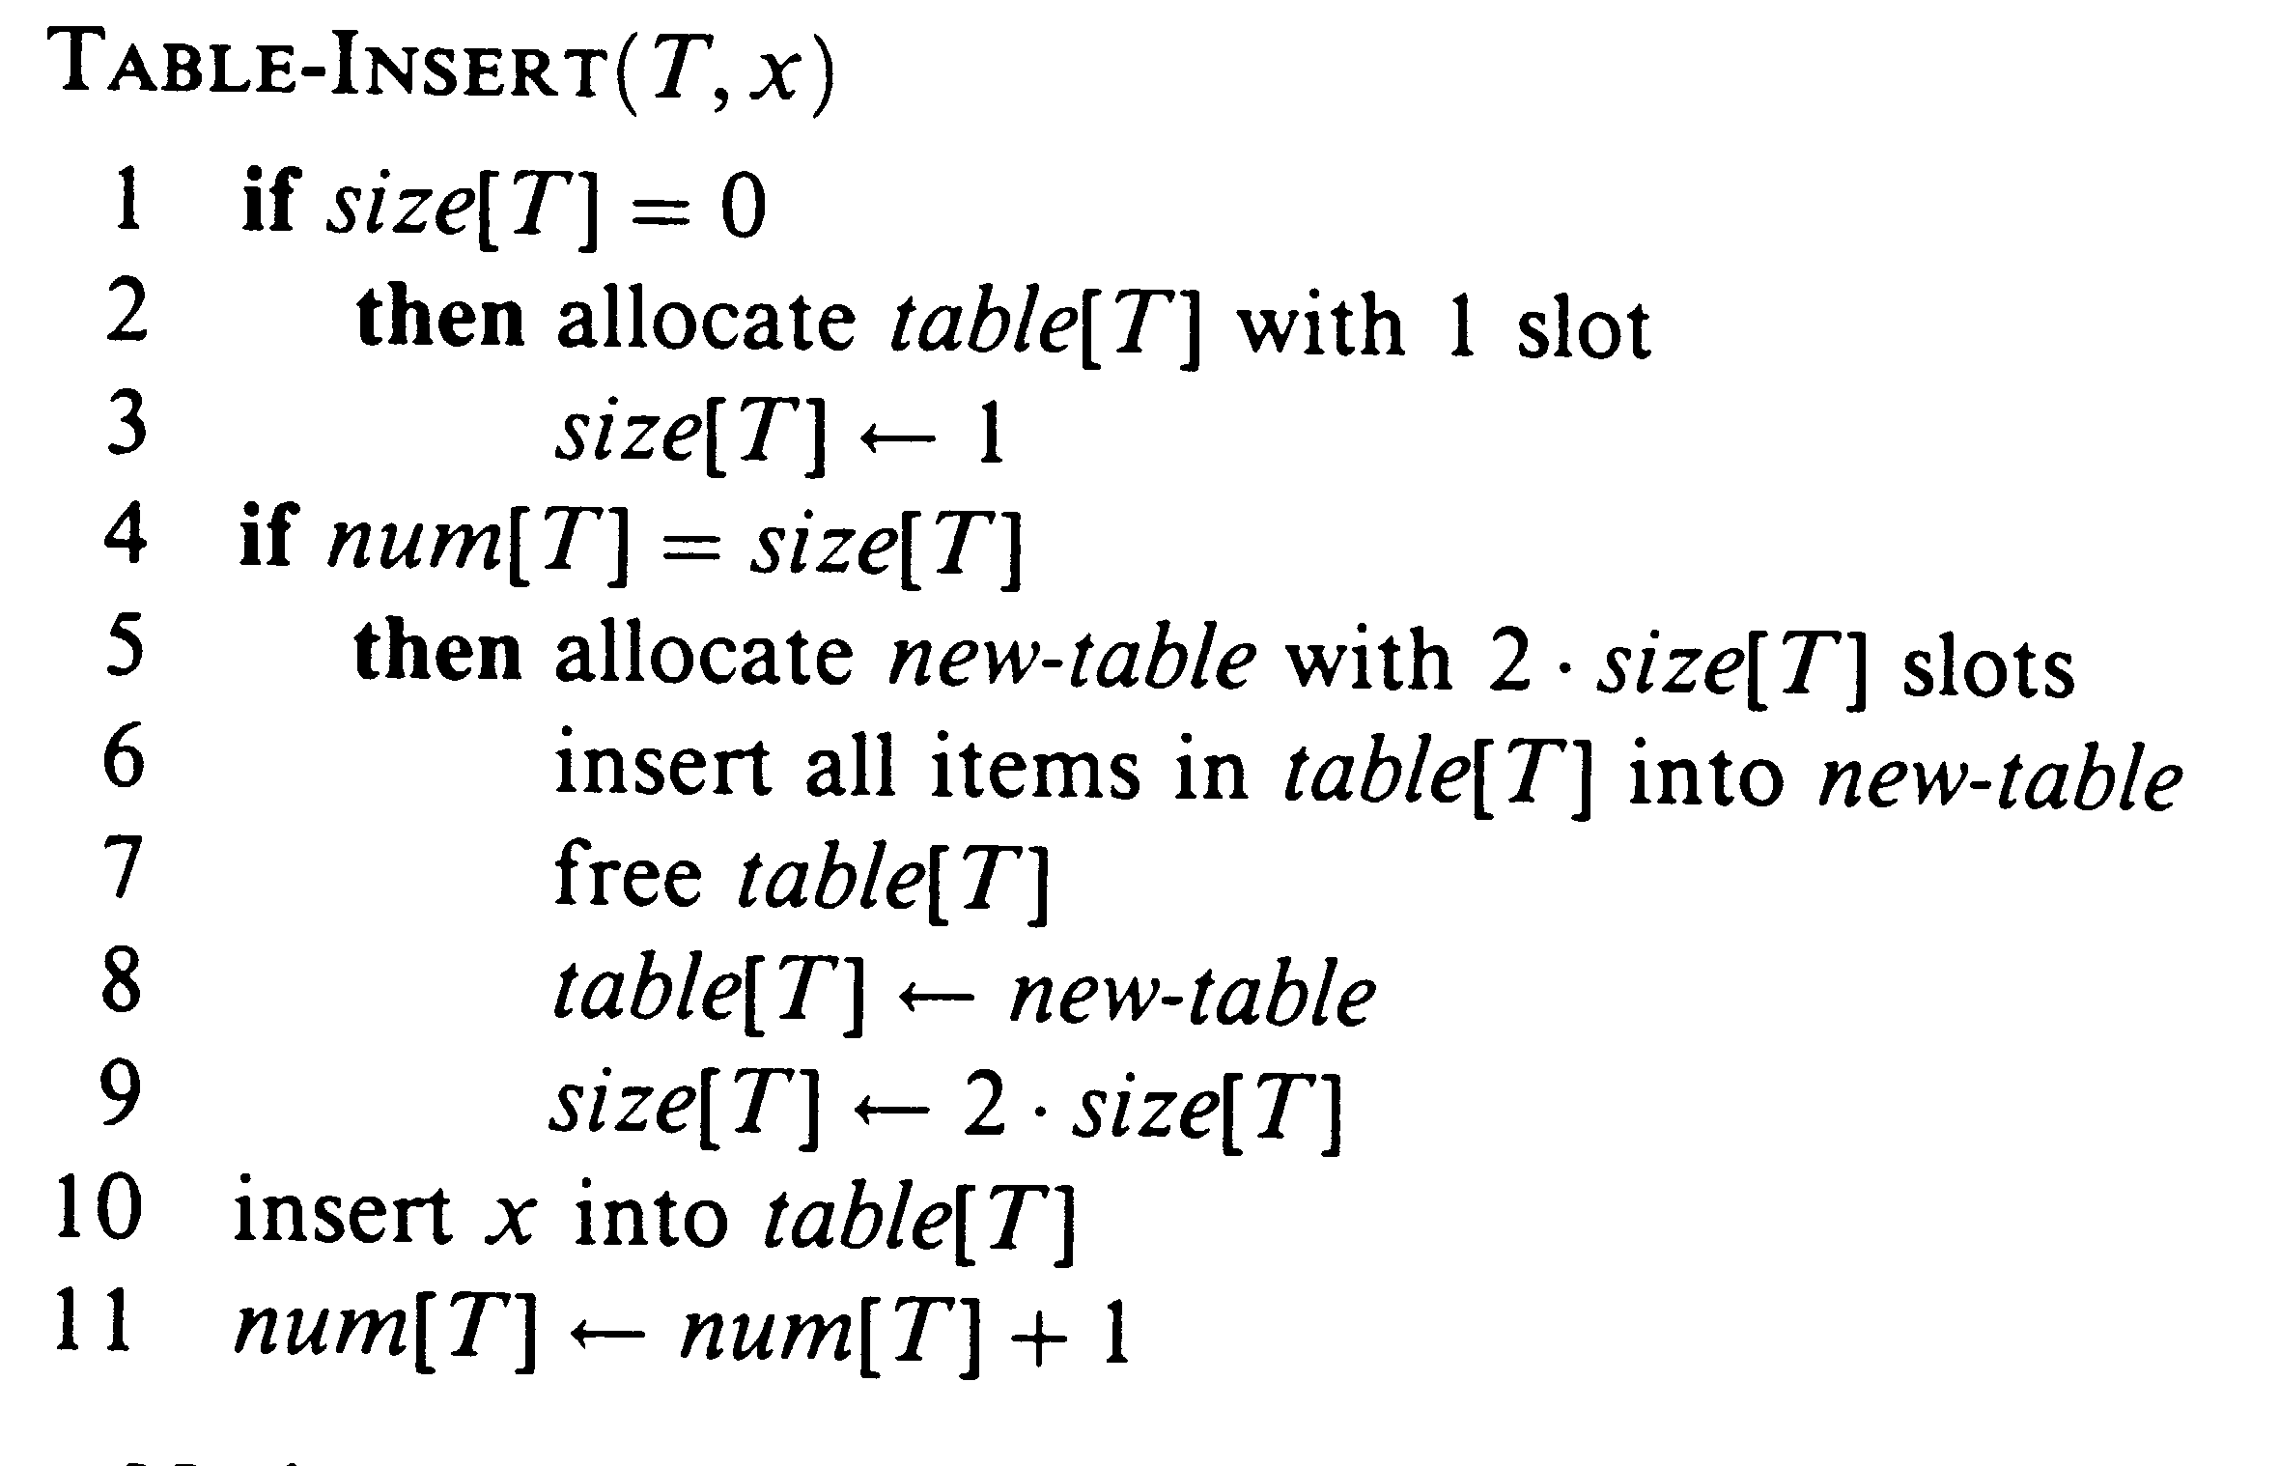
The Insert Operation
Initially num(T)=size(T)=0
Lines 1-3 handle insertion into the empty table
Lines 10-11 occur for every insert operation
Lines 4-9 allow for table expansion
A simple analysis
  the expansion is most expensive, for the i^{th} insertion with expansion we could have c_{i} = i
  for n insertions, worst case is O(n) for each and O(n²) total; but this bound can be improved

Slide 18
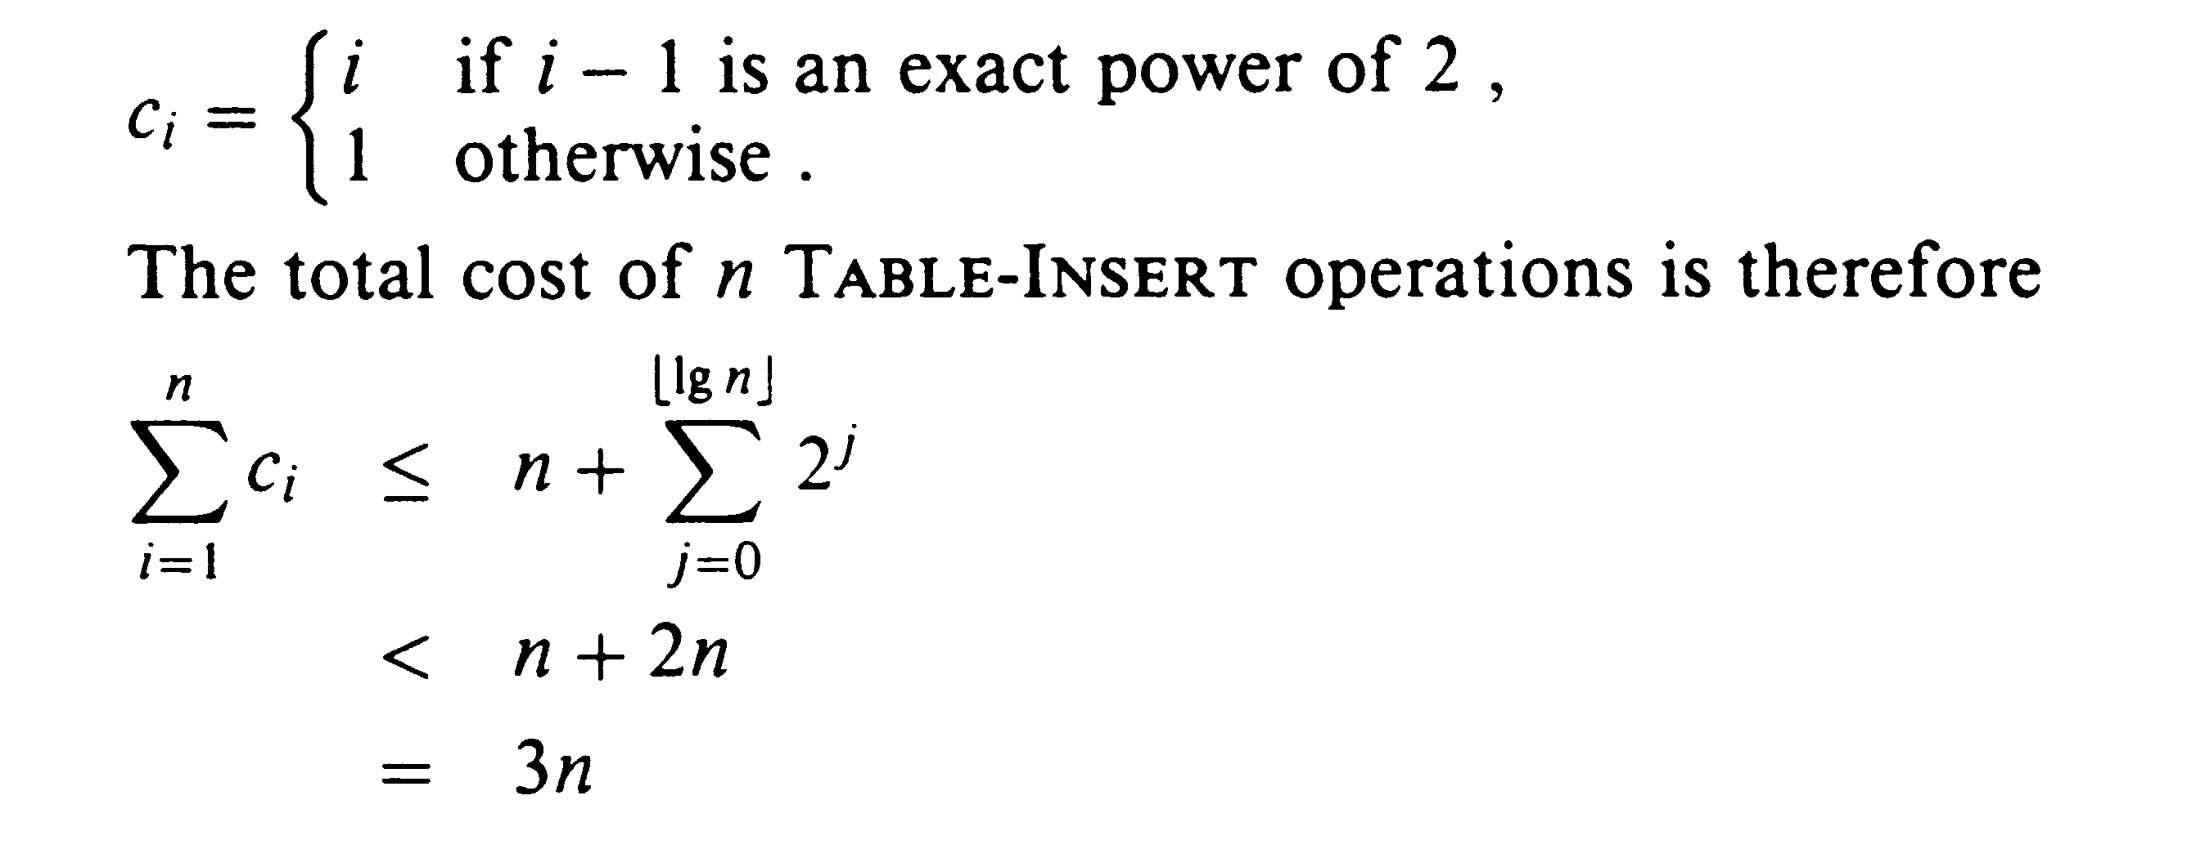
Using the Aggregate Method
Table expansion only occurs at powers of 2
The amortized cost for a single operation is 3

Slide 19
Using the Accounting Method
We set the amortized cost for insert at 3
  intuitive, one for inserting itself into current table
  one for moving itself when the table is expanded
  one for moving another item than has already been moved once the table is expanded
After an expansion to size m for the table
  there is no available credit
  filling the available slots requires 1 actual cost
  a second credit is associated with the item for a copy in the future; a third credit goes to copy an existing item
Therefore, the total amortized cost is 3n

Slide 20
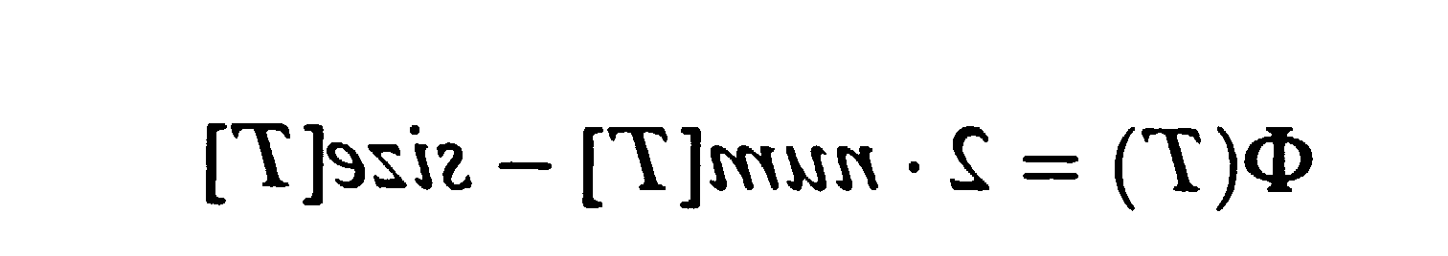
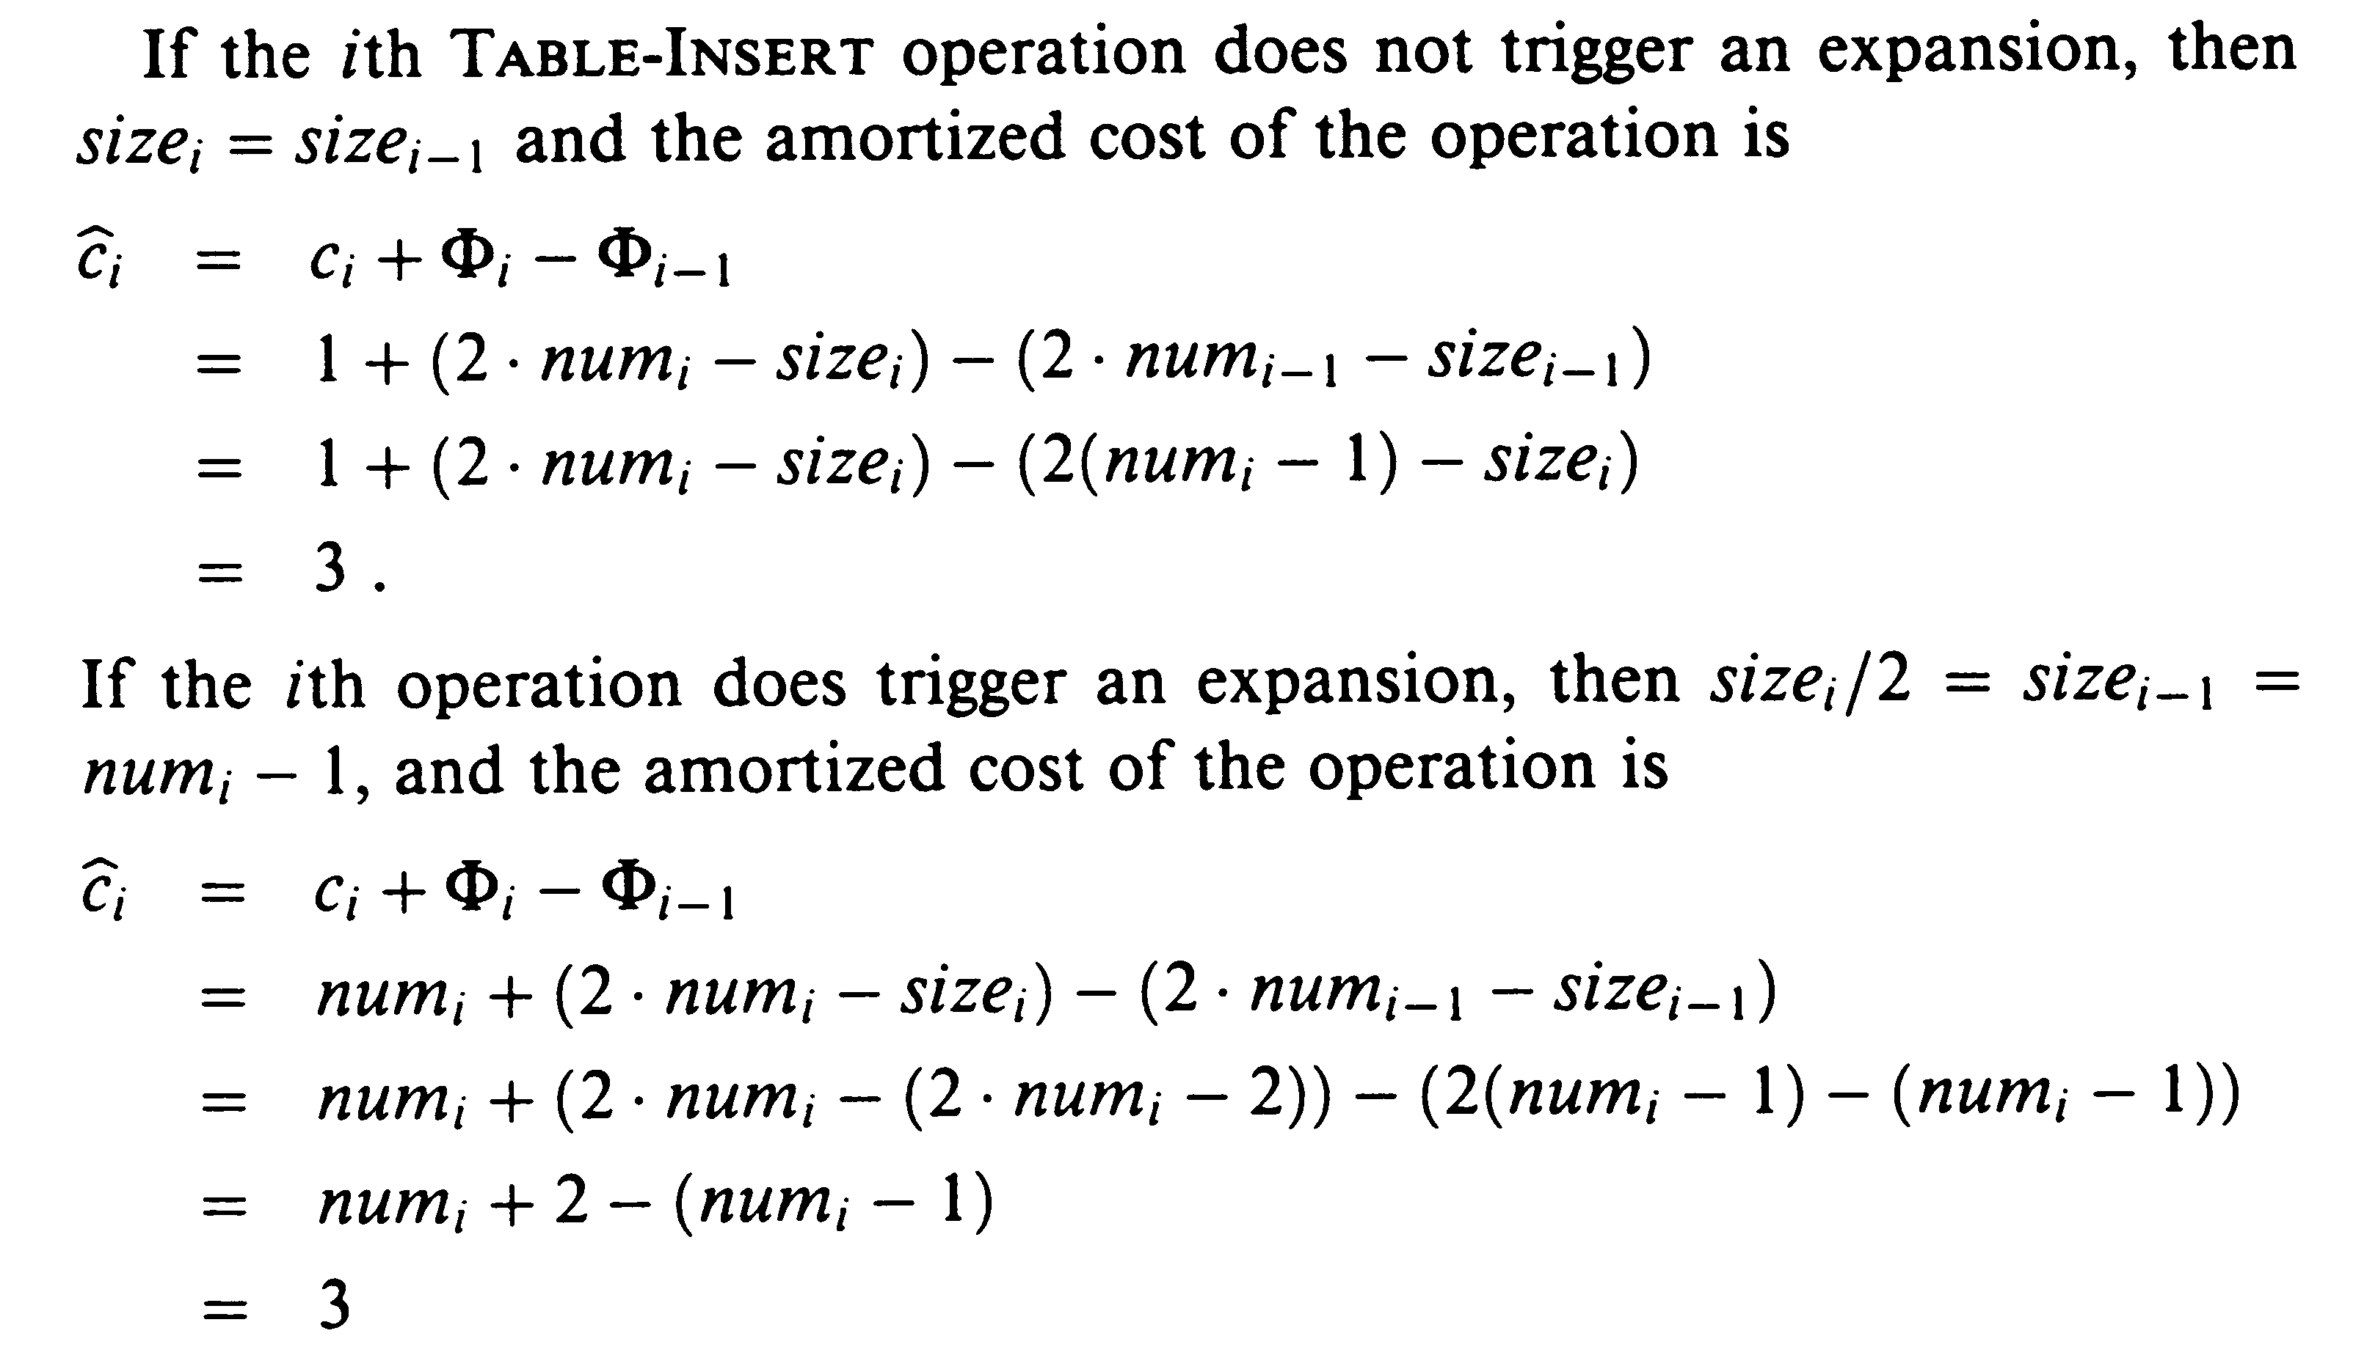
Using the Potential Method
The potential function is
  immediately after expansion, num[T] = size[T]/2 so the potential is 0 (all credits used for expanion)
  immediately before expansion, num[T] = size[T] so the potential is num[T] which will handle the copying
  since num[T] >= size[T]/2, the potential in nonnegative

Slide 21
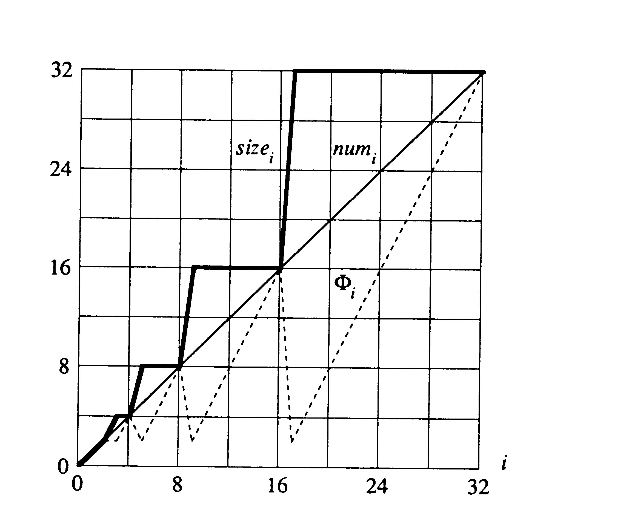
Relationships between Values

Slide 22
Allowing for Table Contractions
Contracting when half full - not a good strategy
  suppose we perform I, D, D, I, I, D, D, I, I, etc. after n/2 insertions
  these operations would alternately expand and contract the table leading to a complexity of O(n²)
  we do not have enough credits to pay for expansion and contraction alternating so quickly
We will expand at 1/2 full but only contract at 1/4
  we earn credits going from 1/2 to 1/4 to make contraction possible
  after the contraction is completed, the load factor is now 1/2 which would allow another contraction

Slide 23
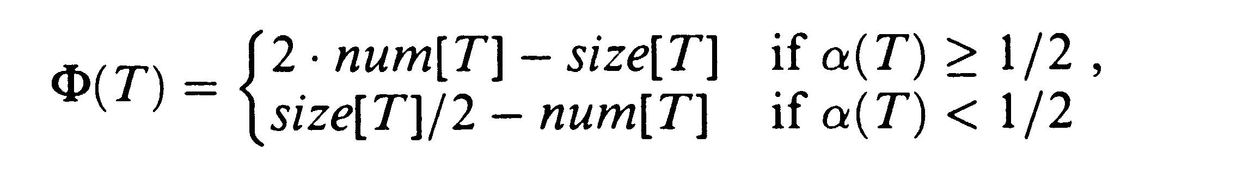
Using the Potential Method
The potential function is
  The potential is 0 after expansion or contraction
  It builds while the load factor increases towards 1 or decreases towards 1/4
  the potential is never negative, so the total amortized cost can be an upper bound
  when the load factor is 1, the potential is num[T], thus the potential can pay for an expansion
  when the load factor is 1/4, the potential is also num[T], so it can pay for a contraction

Slide 24
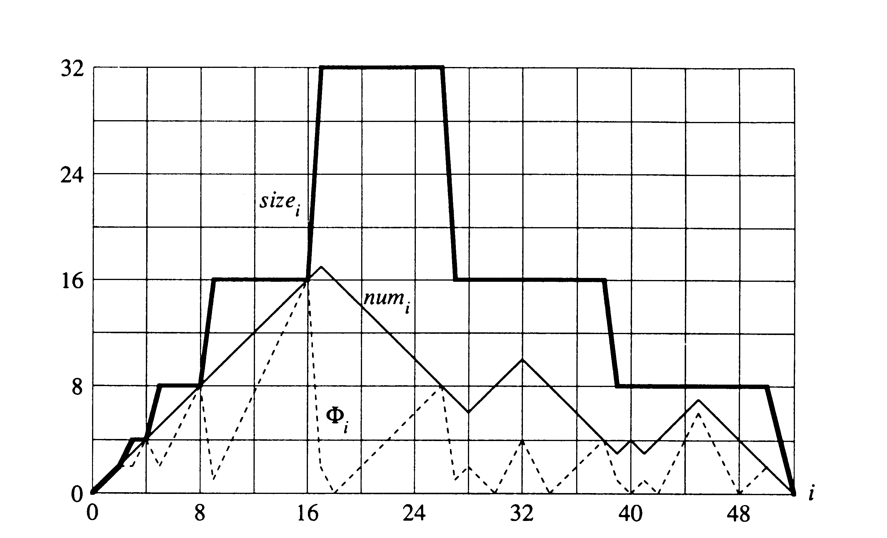
Sample Behavior

Slide 25
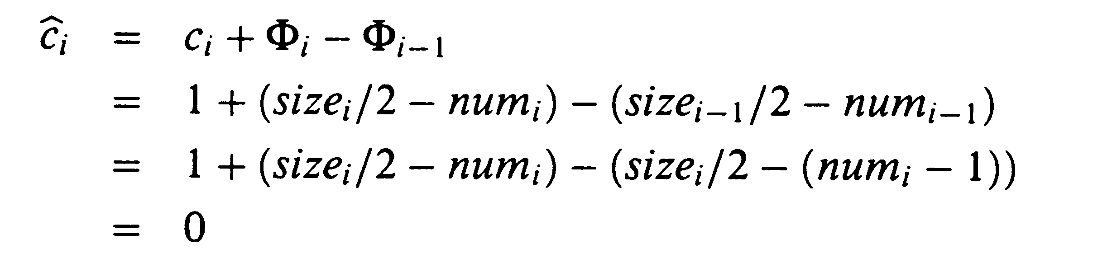
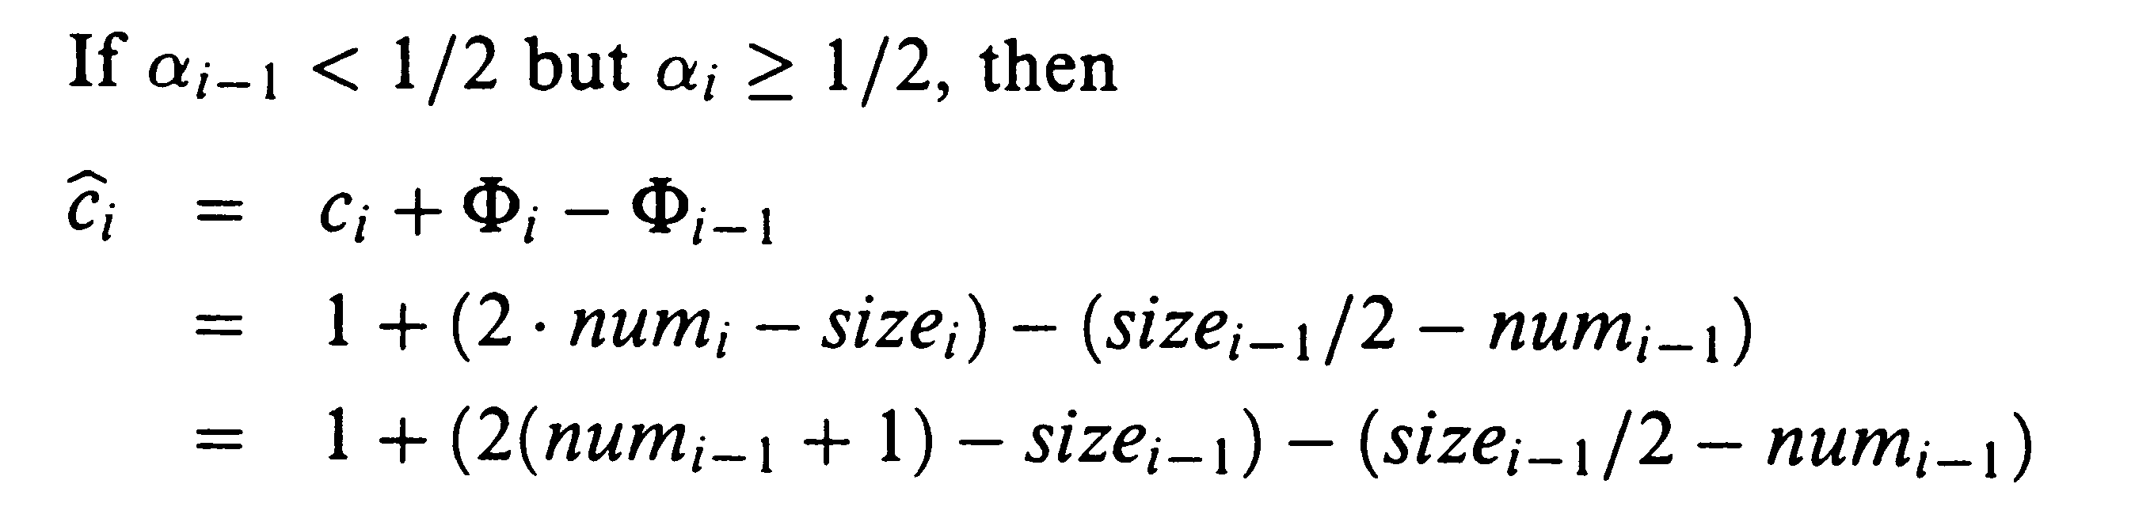
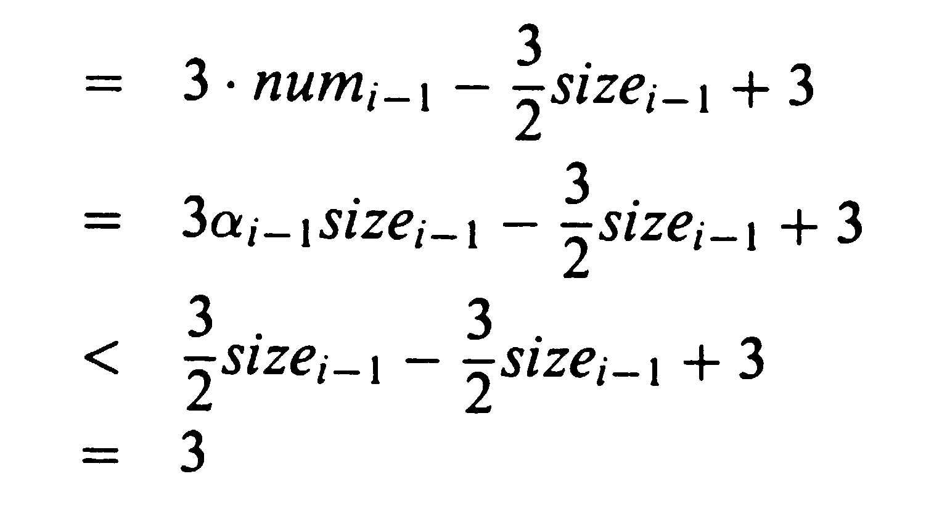
Amortized Cost for Insertion
If α_{i-1} >= 1/2, the analysis is like before with an amortized cost of 3 at most
If α_{i} < 1/2 and α_{i-1} < 1/2 then
Thus the amortized cost of insert is at most 3

Slide 26
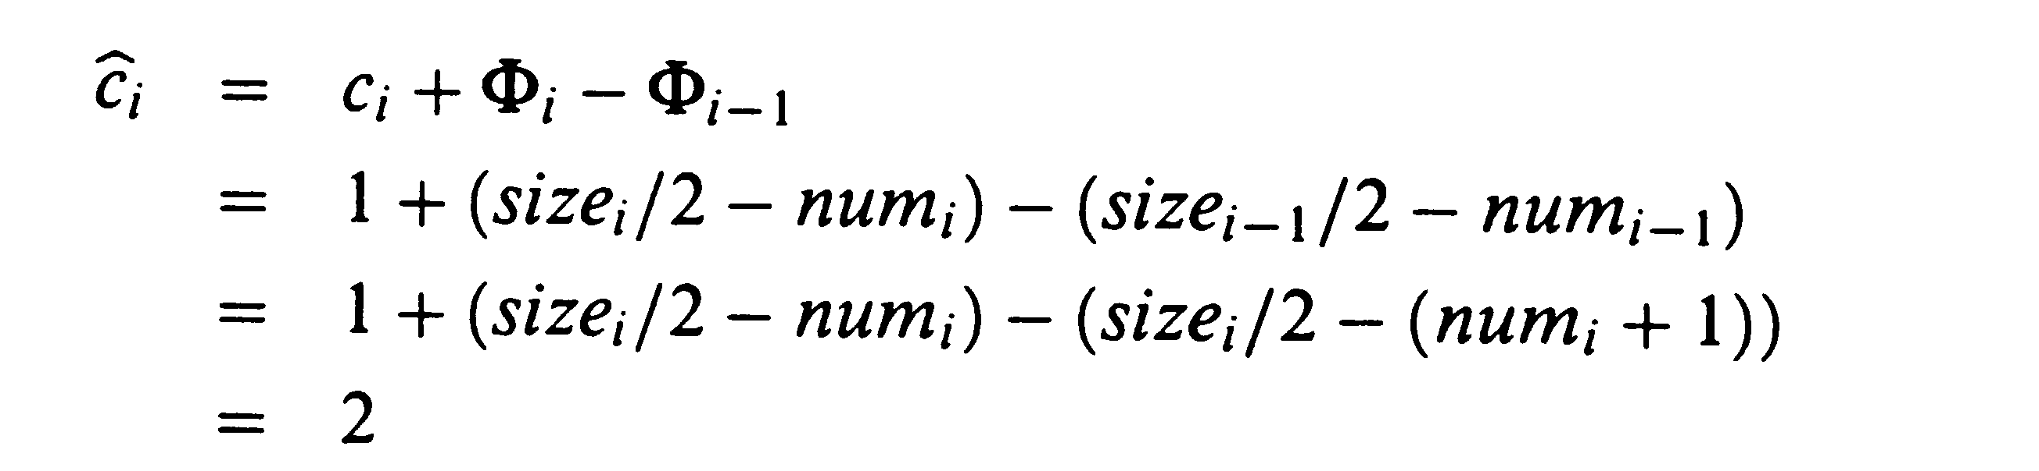
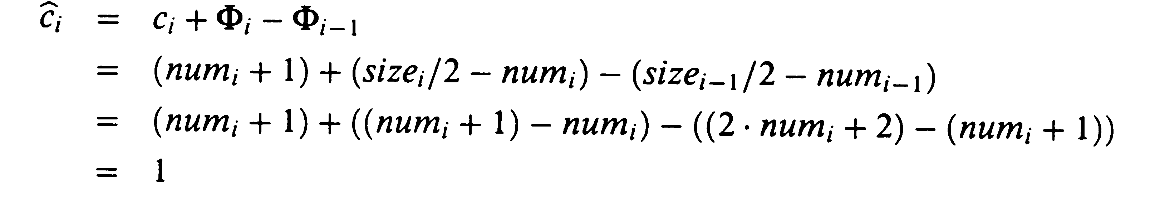
Amortized Cost of Deletion
If α_{i-1} < 1/2 but there is no contraction then
If α_{i-1} < 1/2 and the i^{th} operation causes a contraction then
If α_{i-1} > 1/2 the operation is bounded by a constant (this is exercise 18.4-3)

